Slide 1

MIMIC-III - NLP
Cole Stokes
AI in Healthcare
The University of Texas at Austin
Google Colab - GitHub

Slide 2
Description
This presentation compares the ability of three libraries/models to recognize and extract named entities from medical notes and visualize them through tSNE plots. The medical notes from MIMIC-III are filtered down to include only notes from patients with Neuromyelitis Optica Spectrum Disorder or NMOSD (ICD Code: 3410).
Entities were extracted using Spacy, Scispacy, and blueBERT.
For the Spacy and Scispacy models, Spacy’s Displacy function visualized recognized entities, and gensim was used to create word2vecs.
For each model tSNE plots were created using matplotlib and sklearn for both GloVe 50D (a pre-trained model) and the medical notes for the NMOSD patients.
Note: This dataset is only limited to patients admitted to one hospital, the Beth Israel Deaconess Medical Center in Boston, Massachusetts.

Slide 3

Preprocessing
To get the medical notes for the NMOSD patients, a query was sent to the noteevents table to get the text and was joined with the diagnoses_icd table for patients with the 3410 icd9 code.
Rows are filtered to only contain unique text (duplicate medical notes are removed) to save computation time.
The text is cleaned by removing excess whitespace and uncommon characters. The stamps on the radiology notes are also filtered out using latex.

Slide 4
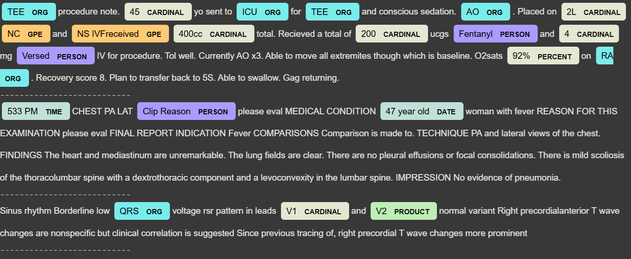
Spacy Entity visualization
We can see that this doesn’t recognize many medical entities or misclassifies them.

Slide 5
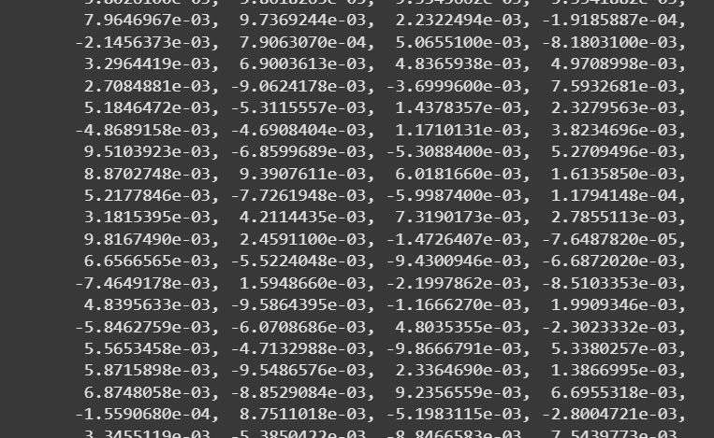
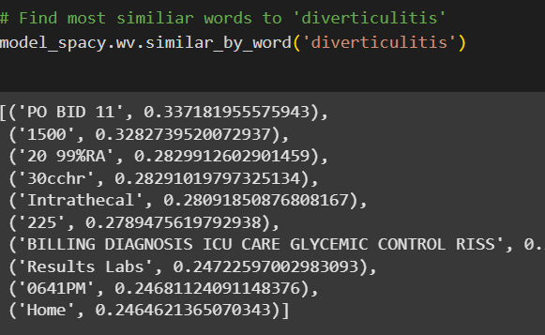
Spacy Word2vec
The word2vec does not strongly map similar entities to diverticulitis.

Slide 6
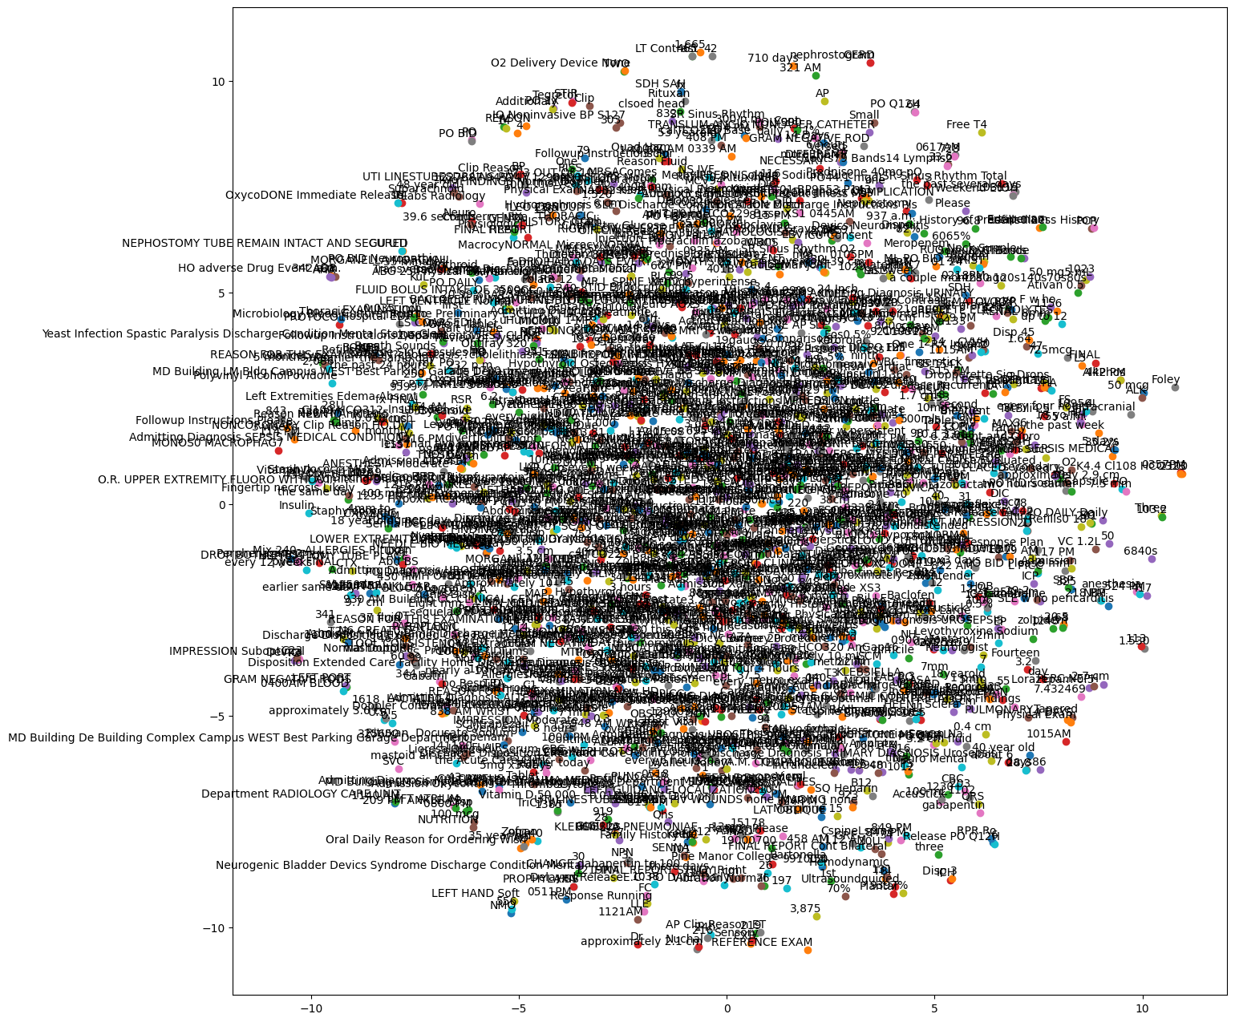
Spacy tSNE plot
This Spacy tSNE plot does not seem to clearly map the similarity of the entities.

Slide 7
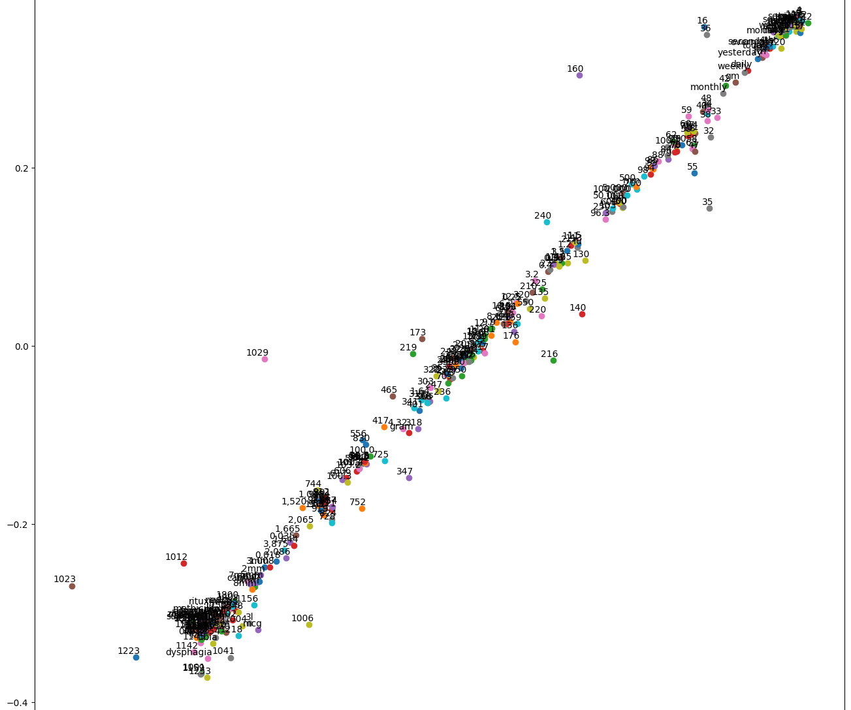
Spacy tsne plot with pre-trained model
This plot shows a bit of an improvement in showing entity similarity.

Slide 8
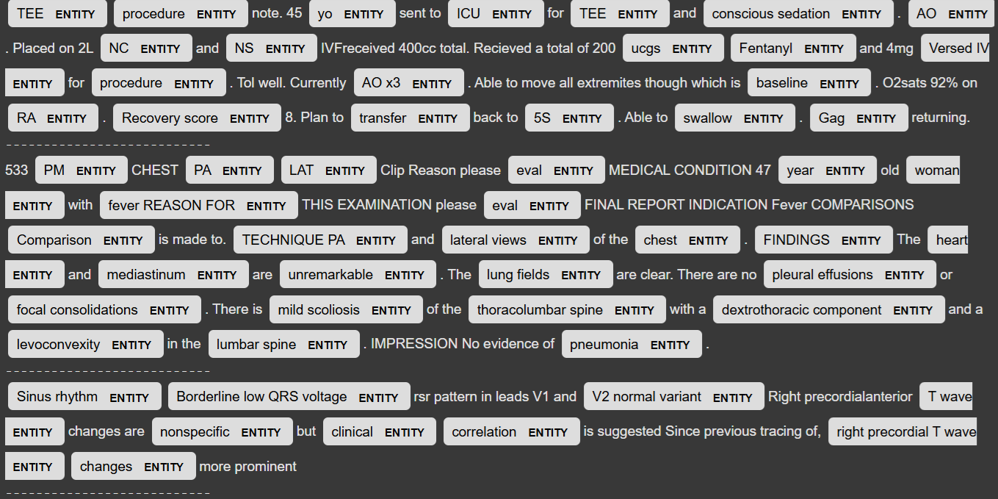
Scispacy entity visualization
Scipacy seems to pick up a lot more entities than spacy and they seem more relevant to the medical field.

Slide 9
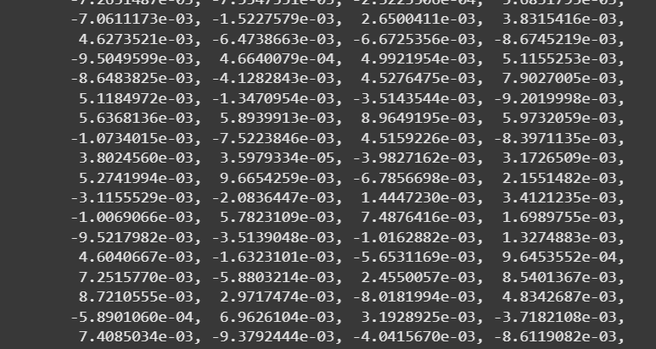
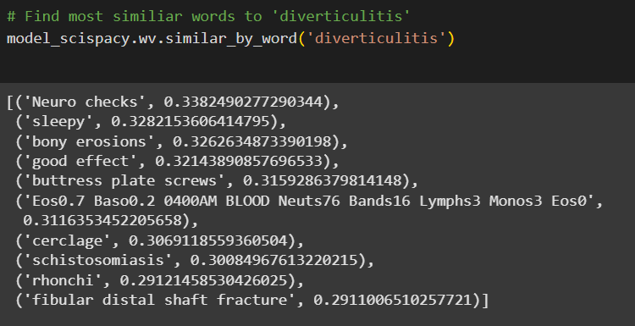
Scispacy word2vec
This word2vec by Scispacy seems to make a bit more sense than Spacy’s however it could still improve.

Slide 10
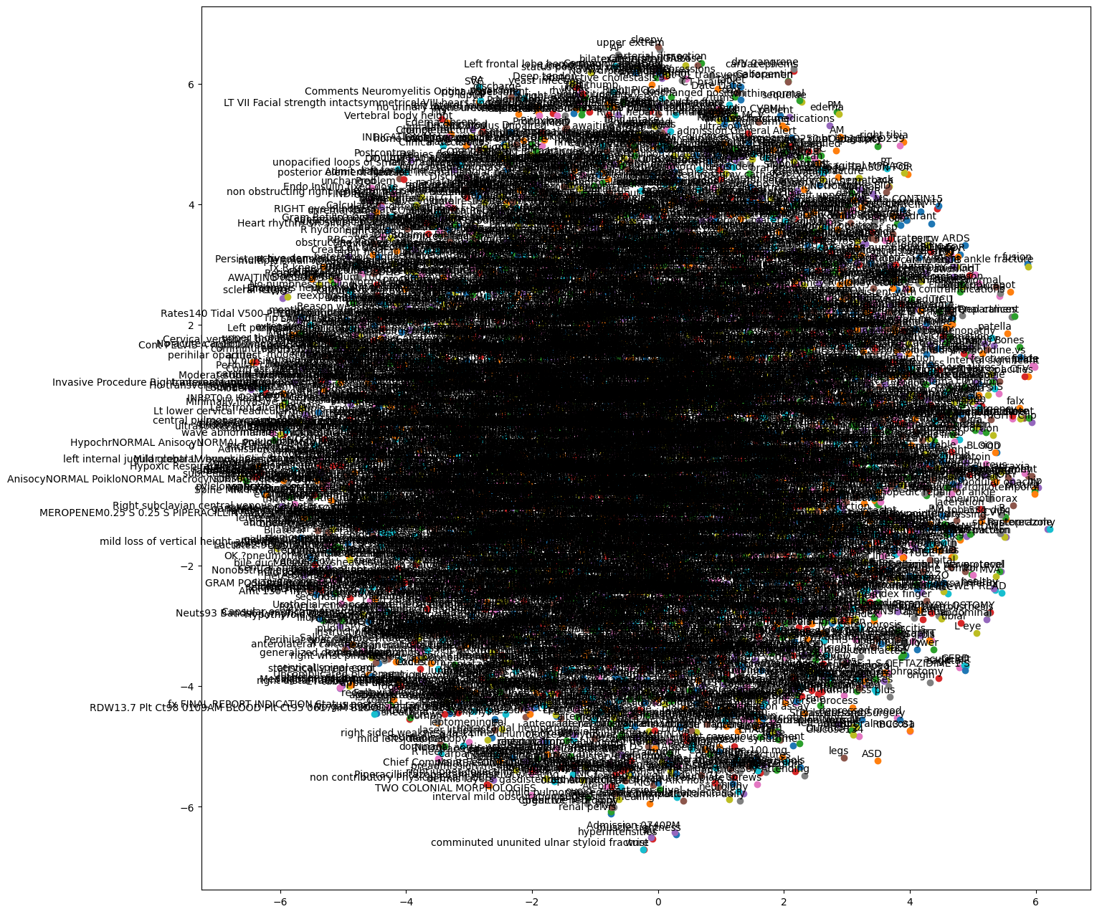
Sispacy tsne plot
We can see from this that Scispacy was able to pick out many more entities that seem more relevant to the medical field. However, it is hard to confirm how well it does in mapping similarity between them.

Slide 11
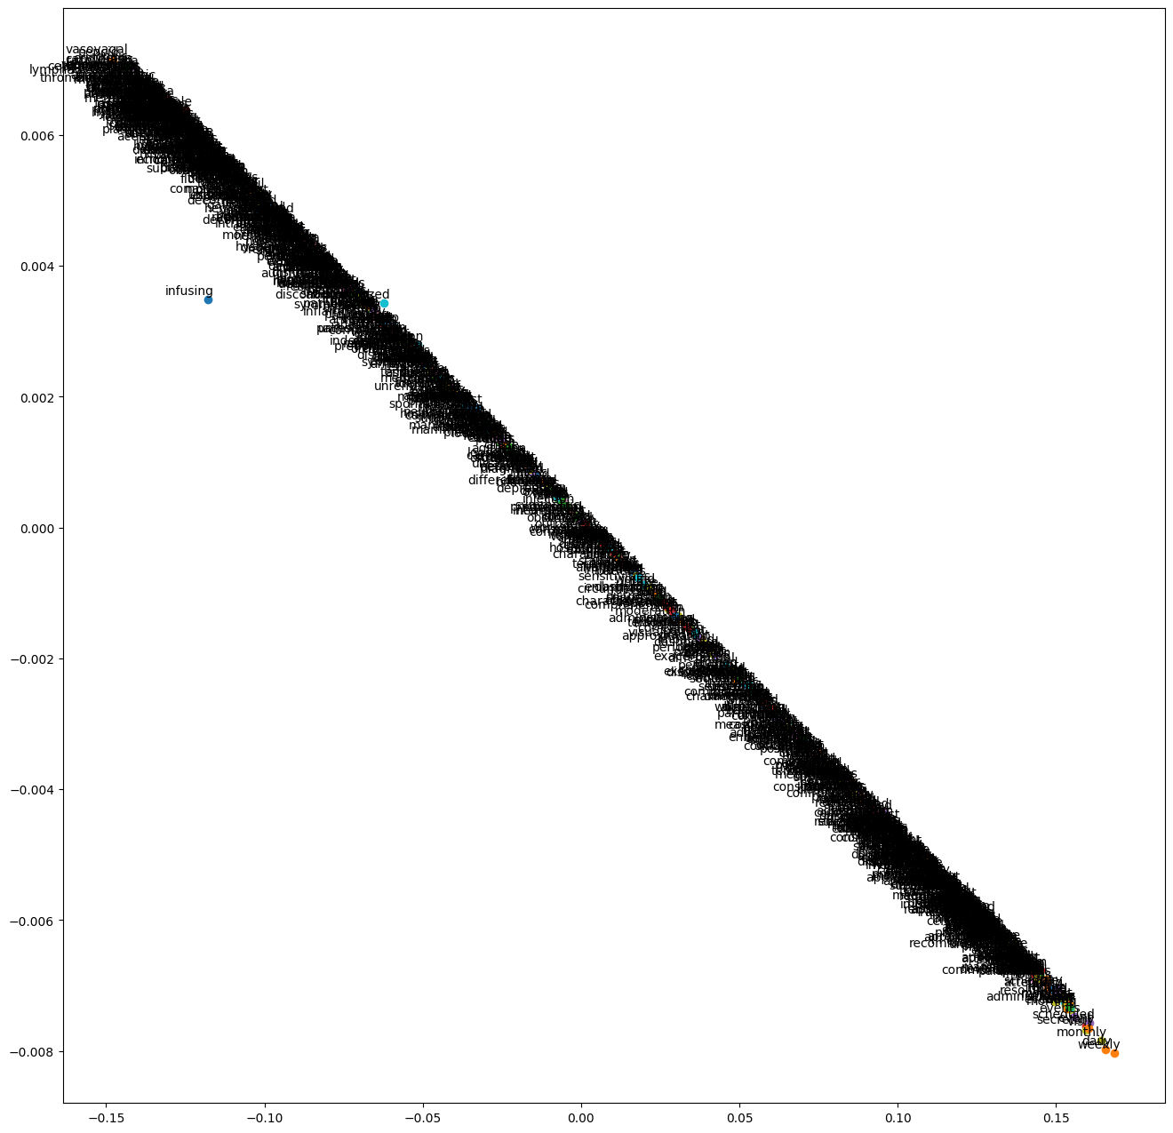
sciSpacy tsne plot with pre-trained model
We can see again that more relevant entities were picked out but is too thick to evaluate. This also shows more words compared to mainly numbers.

Slide 12
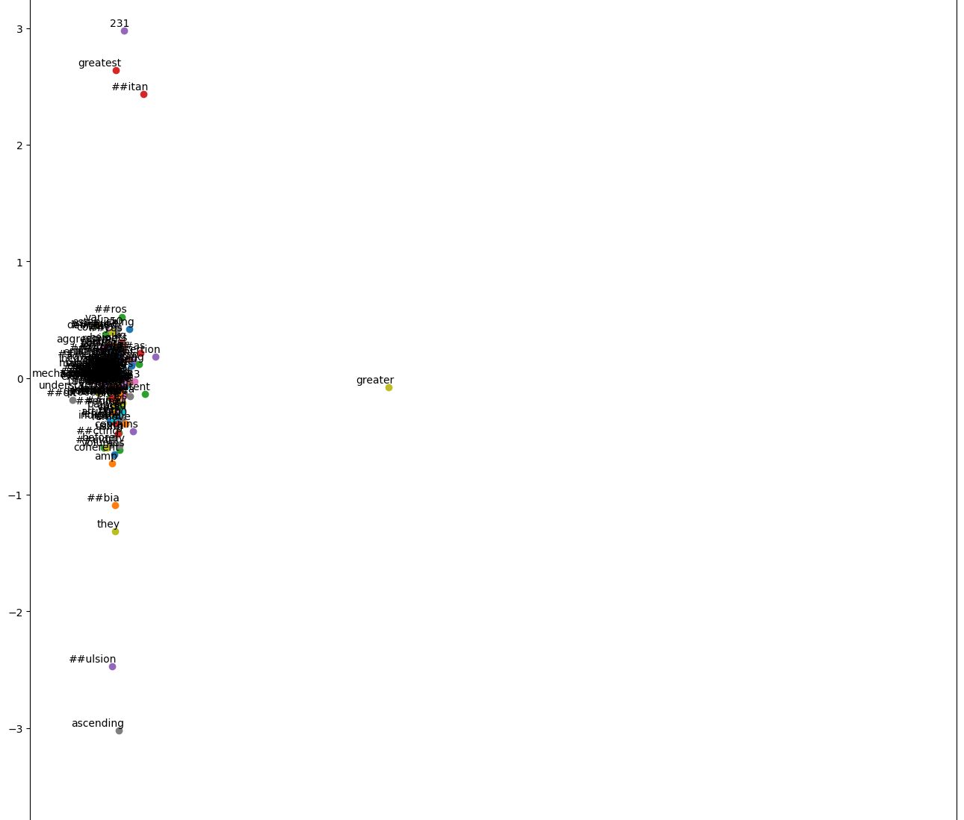
Bluebert tsne plot
blueBert seemed to cluster more words more tightly and not include many entities.

Slide 13
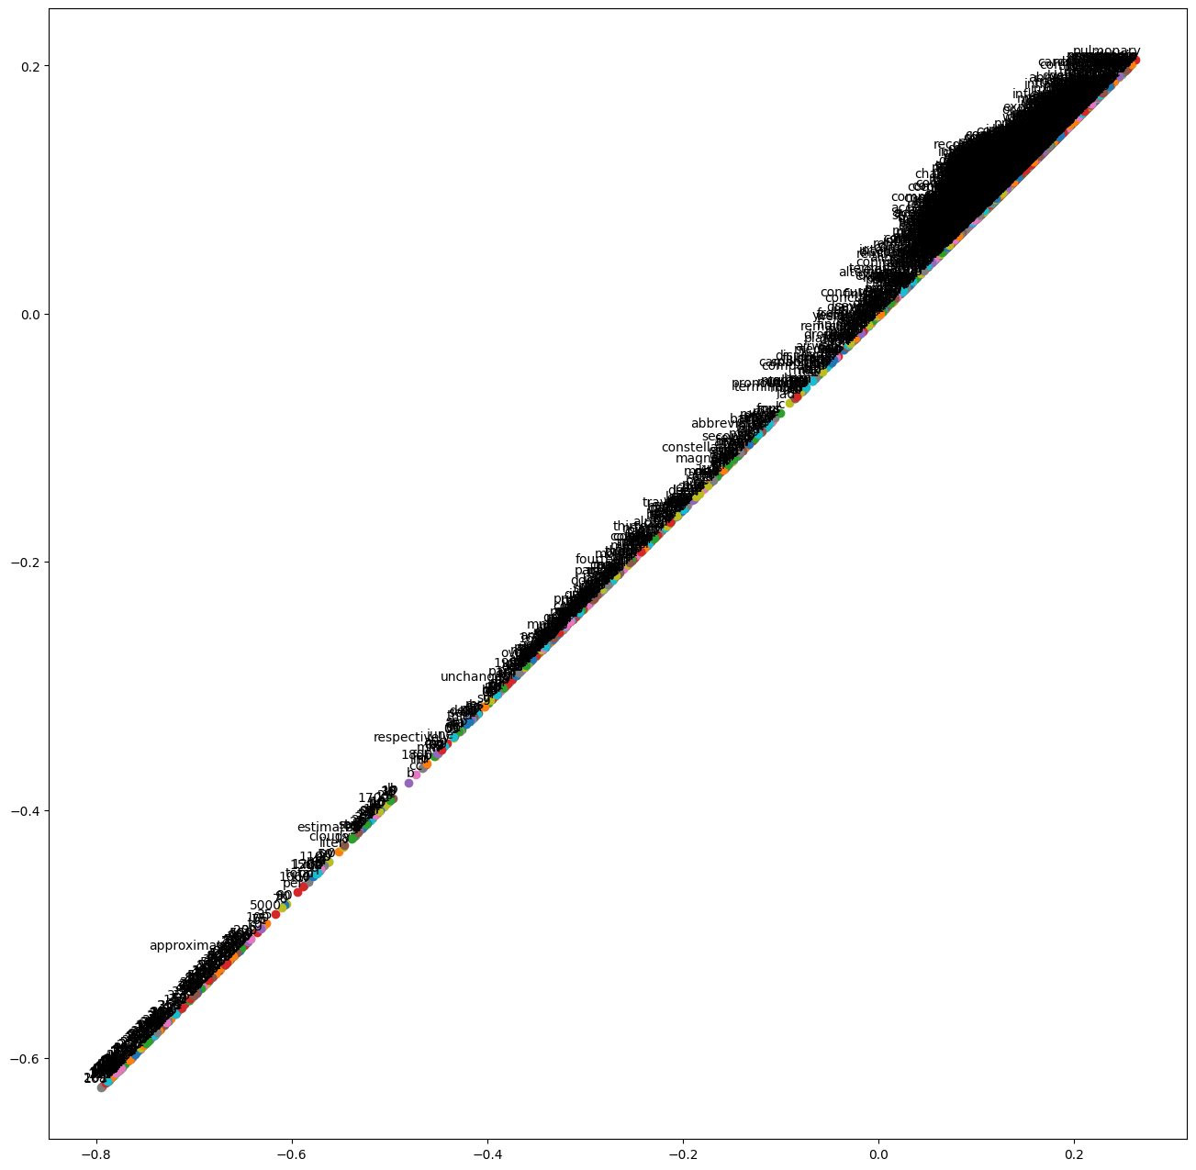
Bluebert tsne plot with pre-trained model
For the pre-trained model, blueBert does fairly well separating most of the words and the numbers. Words like estimate and approximate are close to numbers which makes sense.

Slide 14

Conclusion
Scispacy and blueBERT outperform Spacy in medical entity recognition.
Scispacy captures more relevant terms but struggles with similarity mapping.
blueBERT achieves better clustering but identifies fewer entities overall.
Future improvements include fine-tuning word embeddings on MIMIC-III data and leveraging external biomedical knowledge sources like UMLS and SNOMED-CT.

